Slide 1
Recurrent Neural Networks
Qingrun Zhang

Slide 2
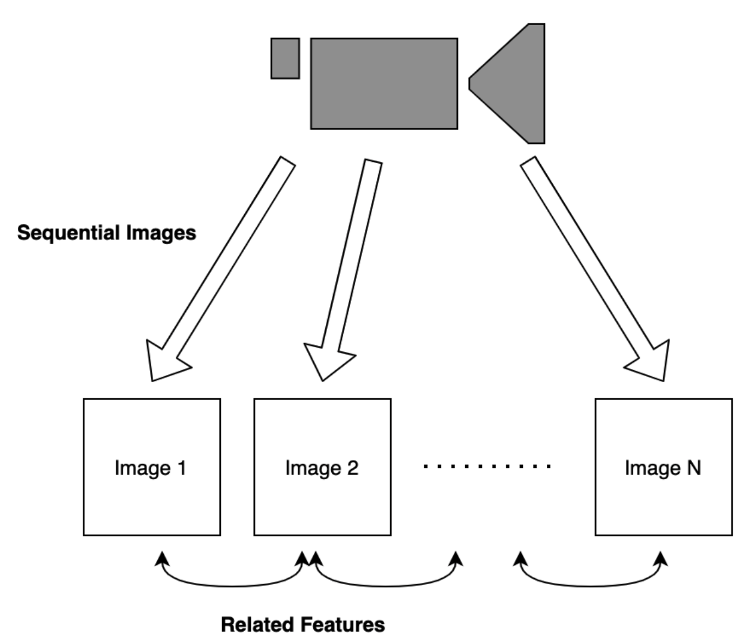
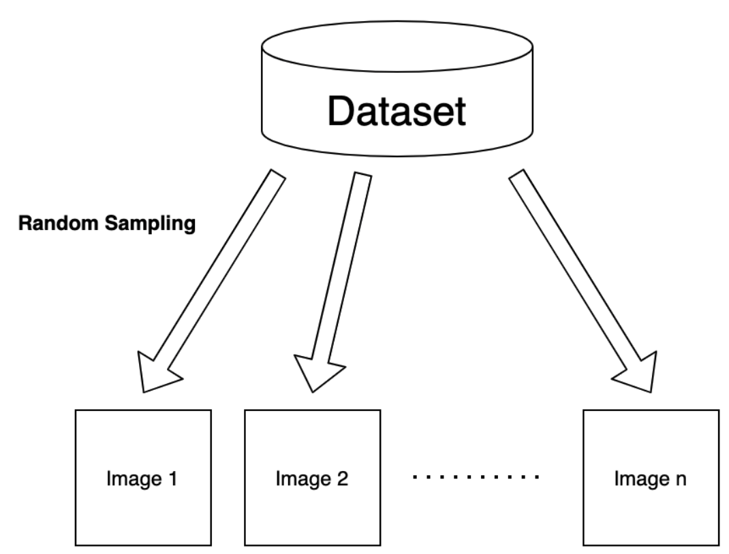
Non-sequential data vs Sequential data
It is a hot dog
The dog is hot
Source: https://naokishibuya.medium.com/recurrent-neural-networks-3c53e40b0376
Notes:
let’s first compare non-sequential data and sequential data to understand the crucial features.In an image classification task, we typically deal with images randomly sampled from a dataset.
Although we may use a batch of input images to train a machine learning model, we assume no correlation exists between selected images. So, the order of input images should not matter. As a result, we train our model to extract the features of each image independently.
Suppose we have a video camera that produces a sequence of images.
Images in time proximity have related features. For example, if the video shows a dog walking in a park. Knowing the current pose of the dog helps predict the next image as they have related features.
A change in the word order makes a considerable difference in the intention of the statement., the two expressions have very different meanings.
simple NN is not suitable to handle sequential data as it ignores the order of inputs and hence the correlation among inputs.

Slide 3
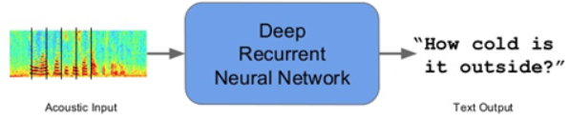
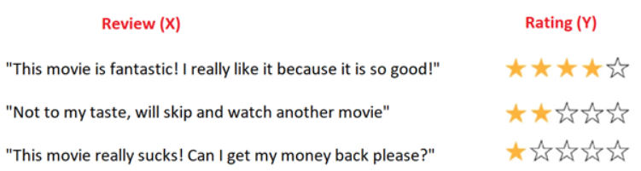
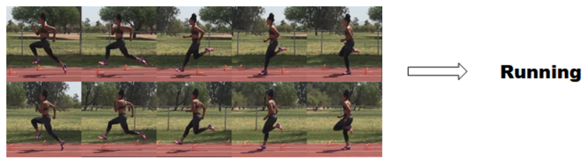
Application field
Speech recognition
Translation
Stock prediction
DNA/RNA sequence analysis
Customer review sentiment analysis
Music generation
Video data to predict motion

Slide 4
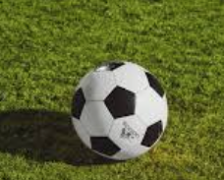
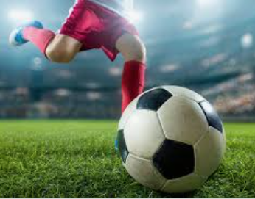
Sequence data and sequential memory
Can you say alphabet backward easily?
Notes:
You want to predict the direction that the ball is moving. So, how would you do this with only the information you see on the left picture? Without knowledge of where the ball has been, you wo
uldn’t have enough data to predict where it’s going. If you record many snapshots of the ball’s position in succession, you will have enough information to make a better prediction.
To get a good intuition behind what sequential memory means, here is the alphabet you have learned, Try to say the alphabet backward, I bet it is much harder.
So there is a very logical reason why this can be difficult. You learn the alphabet as a sequence. Sequential memory is a mechanism that makes it easier for your brain to recognize sequence patterns.

Slide 5
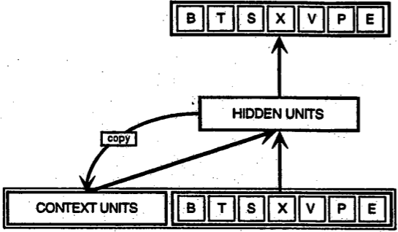
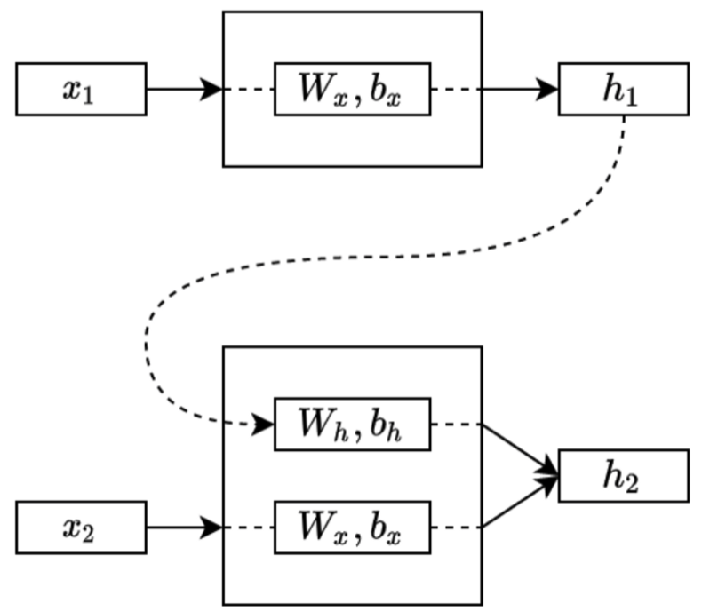
Simple recurrent net
Finding structure in time (Elman, 1990)
Servan-Schreiber, D., Cleeremans, A., and McClelland, J. L. (1991). Graded state machines: The representation of temporal contingencies in simple recurrent networks. Machine Learning, 7:161–193.
Notes:
The Simple Recurrent Network (SRN) was conceived and first used by Jeff Elman, and was first published in a paper entitled Finding structure in time (Elman, 1990)
where the BTSXPE at the bottom of the drawing represents the input example in the current moment, and CONTEXT UNIT represents the output of the previous moment.
The decision a recurrent net reached at time step t-1 affects the decision it will reach one moment later at time step t. So recurrent networks have two sources of input, the present and the recent past, which combine to determine how they respond to new data, much as we do in life.
Recurrent networks are distinguished from feedforward networks by that feedback loop connected to their past decisions, ingesting their own outputs moment after moment as input. It is often said that recurrent networks have memory.2 Adding memory to neural networks has a purpose: There is information in the sequence itself, and recurrent nets use it to perform tasks that feedforward networks can’t.
That sequential information is preserved in the recurrent network’s hidden state, which manages to span many time steps as it cascades forward to affect the processing of each new example. It is finding correlations between events separated by many moments, and these correlations are called “long-term dependencies”, because an event downstream in time depends upon, and is a function of, one or more events that came before. One way to think about RNNs is this: they are a way to share weights over time.
“The past that does not pass away.”

Slide 6
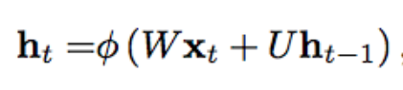
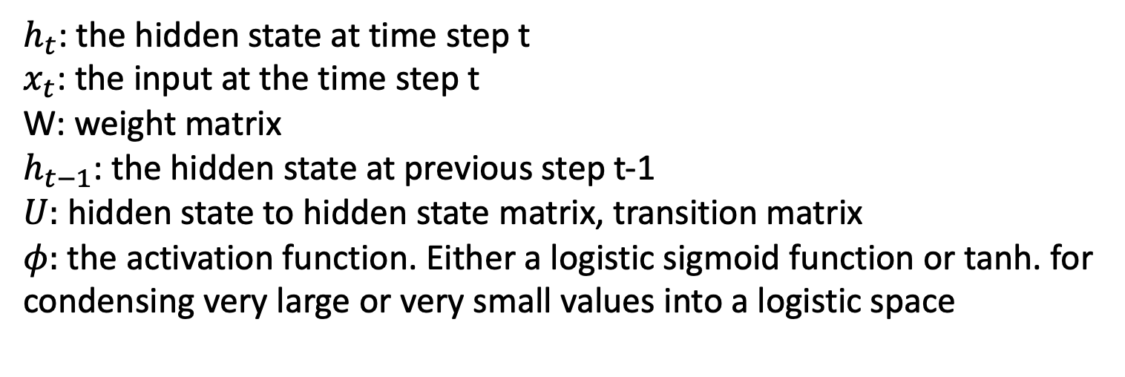
$h_{t}$: the hidden state at time step t
$x_{t}$: the input at the time step t
W: weight matrix
$h_{t−1}$: the hidden state at previous step t-1
$U:$ hidden state to hidden state matrix, transition matrix
$φ:$ the activation function. Either a logistic sigmoid function or tanh. for condensing very large or very small values into a logistic space
Notes:
The weight matrices are filters that determine how much importance to accord to both the present input and the past hidden state. The error they generate will return via backpropagation and be used to adjust their weights until error can’t go any lower.
Because this feedback loop occurs at every time step in the series, each hidden state contains traces not only of the previous hidden state, but also of all those that preceded h_t-1 for as long as memory can persist.

Slide 7
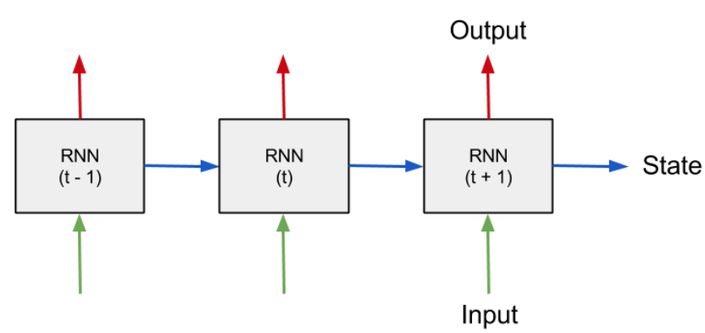
Recurrent Neural Network
https://medium.com/@erikhallstrm/hello-world-rnn-83cd7105b767
Notes:
Recurrent Neural Network”, and is basically a neural network that can be used when your data is treated as a sequence, where the particular order of the data-points matter.
The most straight-forward example is perhaps a time-series of numbers, where the task is to predict the next value given previous values. The input to the RNN at every time-step is the current value as well as a state vector which represent what the network has “seen” at time-steps before. This state-vector is the encoded memory of the RNN, initially set to zero.

Slide 8
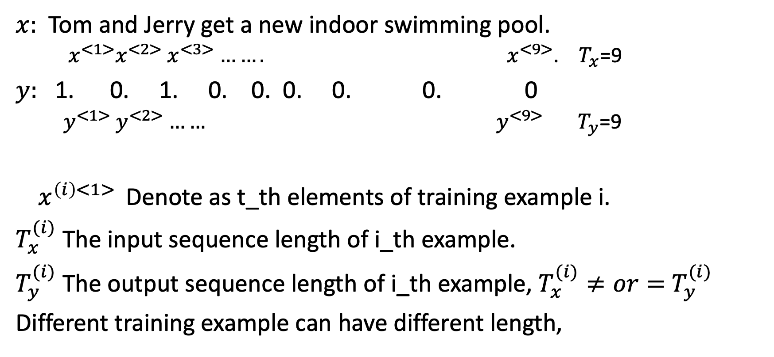
Example and notation
$x:$Tom and Jerry get a new indoor swimming pool.
${ x}^{<1>}x^{<2>}$ $x^{<3>}$ $…….$ $x^{<9>}$. $T_{x}$=9
$y:$ 1. 0. 1. 0. 0. 0. 0. 0. 0
${ y}^{<1>}$ $y^{<2>}$ $……$ $y^{<9>}$ $T_{y}$=9
${ x}^{\left(i\right)<1> }$Denote as t_th elements of training example i.
$T_{x}^{(i)}$ The input sequence length of i_th example.
$T_{y}^{(i)}$ The output sequence length of i_th example, $T_{x}^{(i)}≠or=$ $T_{y}^{(i)}$
Different training example can have different length,
Notes:
let say you want a sequence model to automatically tell you where are the peoples names in this sentence.
So, this is a problem called Named-entity recognition and this is used by search engines for example, to index all of say the last 24 hours news of all the people mentioned in the news articles so that they can index them appropriately.
given this input x let's say that you want a model to operate y that has one outputs per input word and the target output the design y tells you for each of the input words is that part of a person's name.

Slide 9
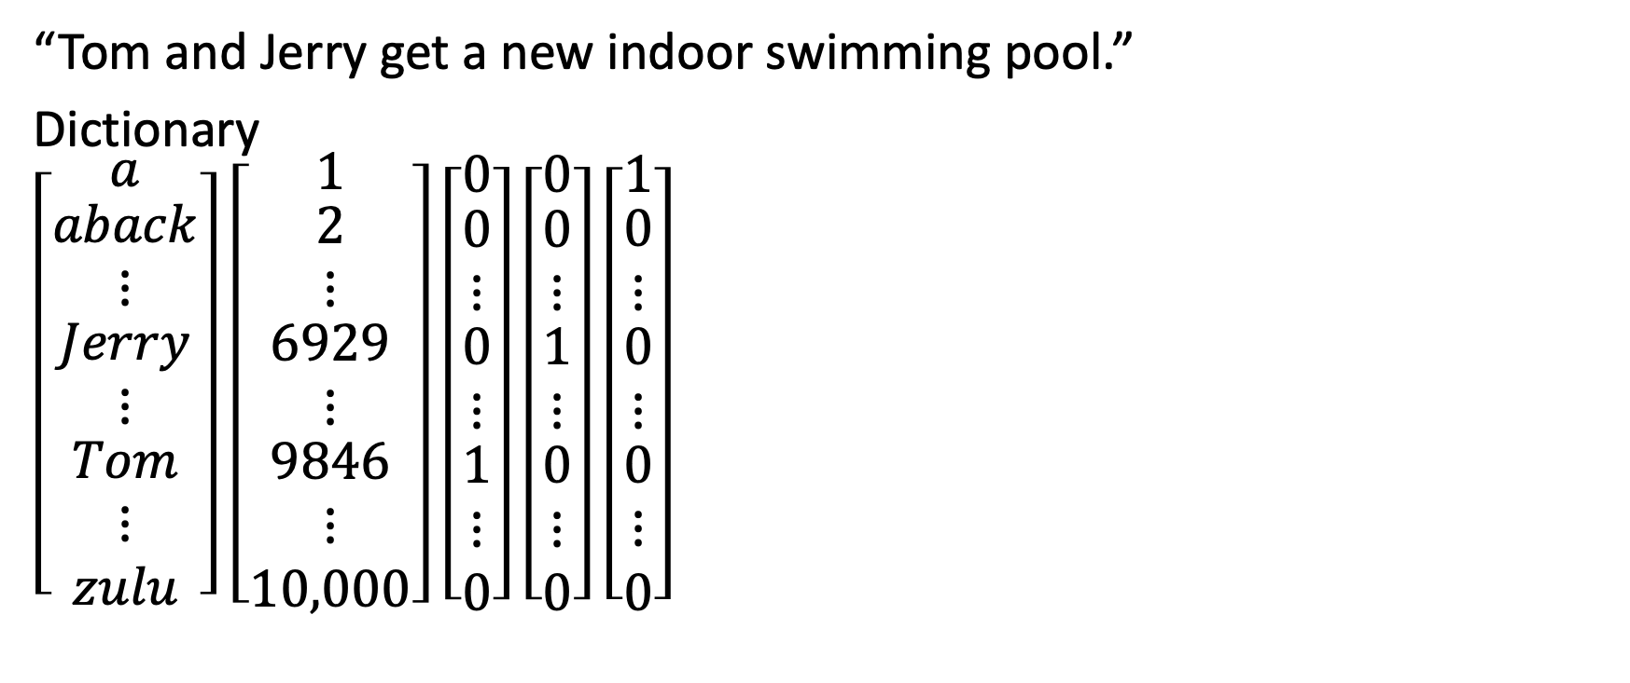
How to represent words in a sentence
“Tom and Jerry get a new indoor swimming pool.”
Dictionary
$\left[\begin{matrix}a \\ \begin{matrix}aback \\ ⋮ \\ \begin{aligned}Jerry \\ ⋮\end{aligned}\end{matrix} \\ \begin{aligned}Tom \\ ⋮ \\ zulu\end{aligned}\end{matrix}\right]$ $\left[\begin{matrix}1 \\ \begin{matrix}2 \\ ⋮ \\ \begin{aligned}6929 \\ ⋮\end{aligned}\end{matrix} \\ \begin{aligned}9846 \\ ⋮ \\ 10,000\end{aligned}\end{matrix}\right]$ $\left[\begin{matrix}0 \\ \begin{matrix}0 \\ ⋮ \\ \begin{aligned}0 \\ ⋮\end{aligned}\end{matrix} \\ \begin{aligned}1 \\ ⋮ \\ 0\end{aligned}\end{matrix}\right]$ $\left[\begin{matrix}0 \\ \begin{matrix}0 \\ ⋮ \\ \begin{aligned}1 \\ ⋮\end{aligned}\end{matrix} \\ \begin{aligned}0 \\ ⋮ \\ 0\end{aligned}\end{matrix}\right]$ $\left[\begin{matrix}1 \\ \begin{matrix}0 \\ ⋮ \\ \begin{aligned}0 \\ ⋮\end{aligned}\end{matrix} \\ \begin{aligned}0 \\ ⋮ \\ 0\end{aligned}\end{matrix}\right]$
A fake word “UNK” for words that is not in the dictionary.
Notes:
To represent a word in the sentence, the first thing to do is come up with a Vocabulary or called Dictionary, that means making a list of the words that you will use in your representations.
a dictionary with size 10,000 words is quite small by modern NLP applications. For commercial applications, for visual size commercial applications, dictionary sizes can be 30 to 50 thousand or more.
you can then use one hot representations to represent each of these words, for example X_1 will be a vector with 1 at position 9846, or the other position as 0.
So in this representation, x_t for each of the values of t in a sentence will be a one-hot vector, you will have nine of them to represent the nine words in this sentence.
And the goal is given this representation for X to learn a mapping using a sequence model to then target output y, I will do this as a supervised learning problem,
if you encounter a word that is not in your vocabulary? The solution is to create a new token or a new fake word called Unknown Word

Slide 10
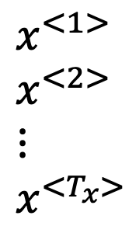
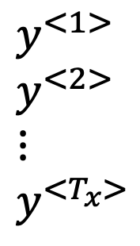
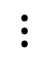
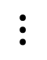
Standard Neural Network?
$$x^{<1>}$$
$$x^{<2>}$$
$⋮$ $x^{<T_{x}>}$
$$y^{<1>}$$
$$y^{<2>}$$
$⋮$ $y^{<T_{x}>}$
$$⋮$$
$$⋮$$
$$⋮$$
Problems:
Input and output can have different length in different examples
Precludes modeling long-range dependencies.
Enormous number of parameters
Notes:
Each of the input words is a 10,000 dimensional one-hot vector and so this is just a very large input layer if the total input size was maximum number of words times 10,000. A weight matrix of this first layer will end up having an enormous number of parameters.
what we saw in convolutional neural networks where things learned for one part of the image can be generalized quickly to other parts of the image, and we like a similar effects for sequence data.
Using a better representation will also let you reduce the number of parameters in your model.

Slide 11
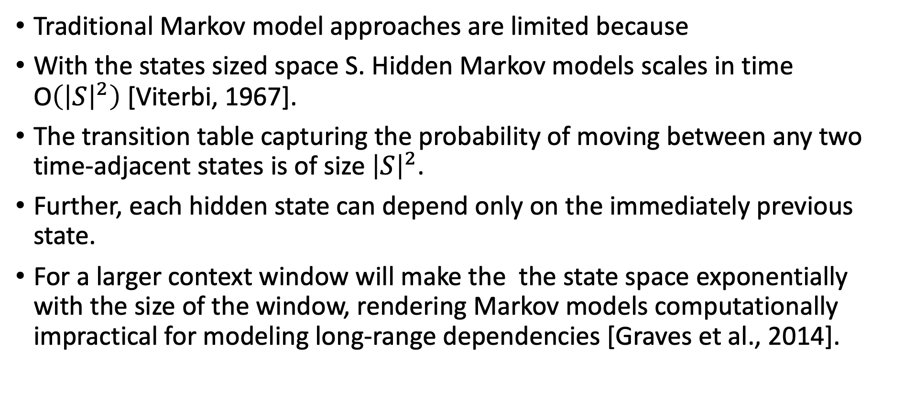
Why not Markov Models?
Traditional Markov model approaches are limited because
With the states sized space S. Hidden Markov models scales in time O$\left({\left|S\right|}^{2}\right)$[Viterbi, 1967].
The transition table capturing the probability of moving between any two time-adjacent states is of size ${\left|S\right|}^{2}$.
Further, each hidden state can depend only on the immediately previous state.
For a larger context window will make the the state space exponentially with the size of the window, rendering Markov models computationally impractical for modeling long-range dependencies [Graves et al., 2014].
Lipton & Berkowitz 2015: A Critical Review of Recurrent Neural Networks for Sequence Learning
Notes:
Markov chains, which model transitions between states in an observed sequence, were first described by the mathematician Andrey Markov in 1906. Hidden Markov models (HMMs), which model an observed sequence as probabilistically dependent upon a sequence of unobserved states, were described in the 1950s
However, traditional Markov model approaches are limited because their states must be drawn from a modestly sized discrete state space S. The dynamic programming algorithm that is used to perform efficient inference with hidden Markov models scales in time O(|S|2) [Viterbi, 1967]. Further, the transition table capturing the probability of moving between any two time-adjacent states is of size |S|2. Thus, standard operations become infeasible with an HMM when the set of possible hidden states grows large. Further, each hidden state can depend only on the immediately previous state. While it is possible to extend a Markov model to account for a larger context window by creating a new state space equal to the cross product of the possible states at each time in the window, this procedure grows the state space exponentially with the size of the 3window, rendering Markov models computationally impractical for modeling long-range dependencies

Slide 12
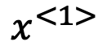
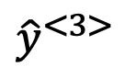
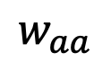
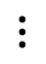
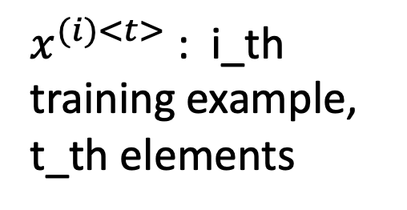
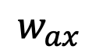
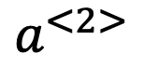
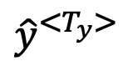
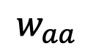
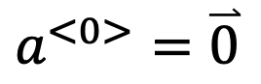
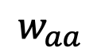
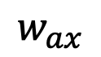
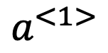
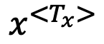
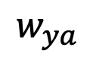
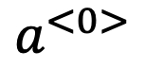
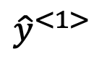
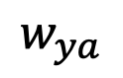
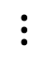
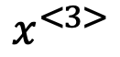
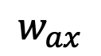
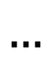
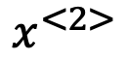
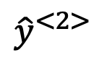
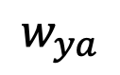
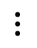
Recurrent Neural Network – forward propagation
$${\hat{y}}^{<1>}$$
$${\hat{y}}^{<2>}$$
$${\hat{y}}^{<3>}$$
$${\hat{y}}^{<T_{y}>}$$
$$w_{ya}$$
$$w_{ya}$$
$$w_{ya}$$
$$w_{ya}$$
$x^{(i)<t>}$: i_th training example, t_th elements
$$a^{<0>}$$
$$a^{<1>}$$
$$a^{<2>}$$
$$…$$
$$w_{aa}$$
$$⋮$$
$$w_{aa}$$
$$⋮$$
$$w_{aa}$$
$$⋮$$
$$⋮$$
$$w_{aa}$$
$$w_{ax}$$
$$w_{ax}$$
$$w_{ax}$$
$$w_{ax}$$
$$a^{<0>}=\overset{⃑}{0}$$
$$x^{<1>}$$
$$x^{<2>}$$
$$x^{<3>}$$
$$x^{<T_{x}>}$$
She said “Teddy is a great teacher”
She said “Teddy bears is on sale”
Notes:
For the recurrent neural network, we will feed the first word X1, into a neural network layer. the neural network will try to predict the output. when move to the second words x2, instead of just predicting y2 using only X2, it also gets to input some information from step one.
So in particular, the activation value from time step one is passed on to time step two and so on until the last word Tx Ty. So at each time step, the RNN passes on an activation to the next time step. And to kick off the whole thing, we'll have made-up activation at time zero, this is usually the vector of zeros.
Wax and is the same parameters uses for every time step. And similarly for Waa and Way
So, in this recurrent neural network, when making the prediction for y3, it gets the information not only from X3 but also the information from x1 and x2 because the information on x1 can pass through this way to help to prediction with Y3. One weakness of this RNN is that it only uses the information that is earlier in the sequence to make a prediction. In particular, when predicting y3, it doesn't use information about the words X4, X5, X6 and so on.

Slide 13
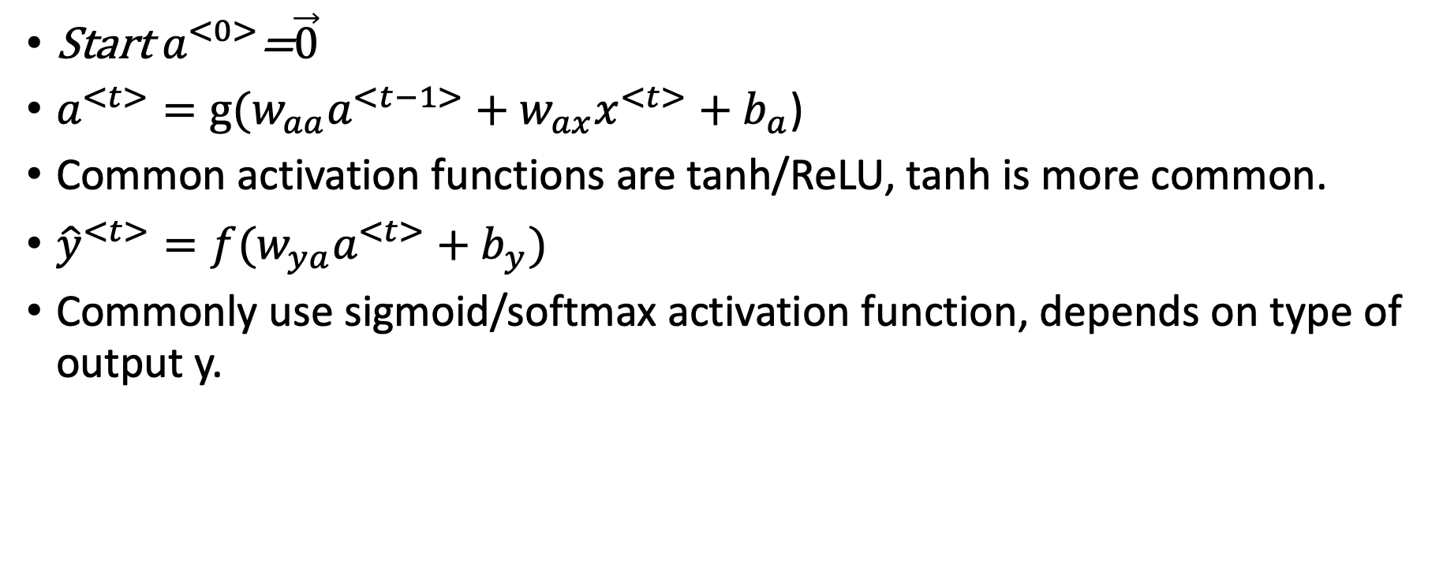
What does RNN calculate?
Start $a^{<0>}$=$\vec{0}$
$a^{<t>}=g(w_{aa}a^{<t−1>}+w_{ax}x^{<t>}+b_{a}$)
Common activation functions are tanh/ReLU, tanh is more common.
${\hat{y}}^{<t>}=f(w_{ya}a^{<t>}+b_{y})$
Commonly use sigmoid/softmax activation function, depends on type of output y.

Slide 14
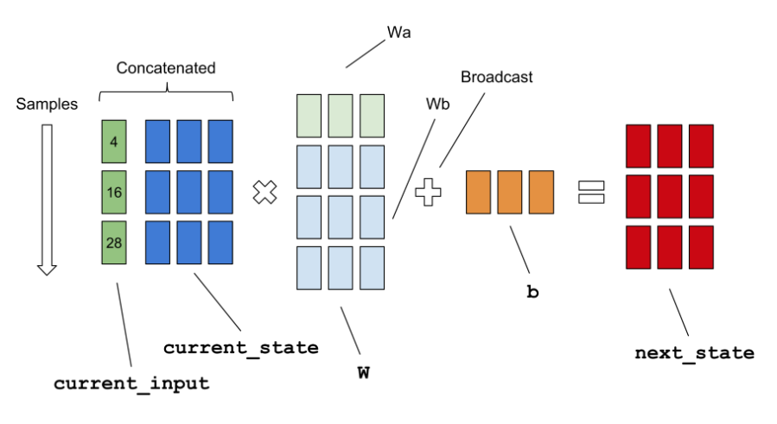
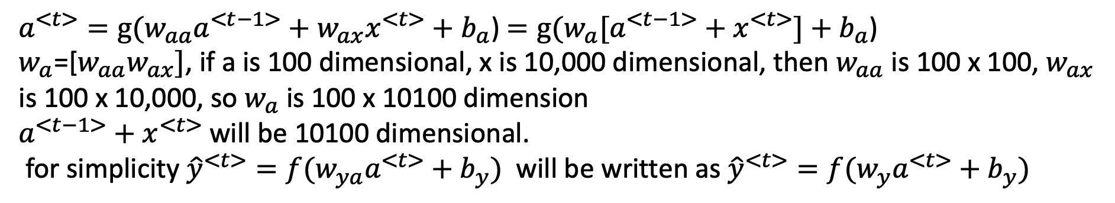
$a^{<t>}=g(w_{aa}a^{<t−1>}+w_{ax}x^{<t>}+b_{a}$) $=g(w_{a}[a^{<t−1>}+x^{<t>}]+b_{a}$)
$w_{a}$=[$w_{aa}w_{ax}]$, if a is 100 dimensional, x is 10,000 dimensional, then $w_{aa}$ is 100 x 100, $w_{ax}$ is 100 x 10,000, so $w_{a}$ is 100 x 10100 dimension
$a^{<t−1>}+x^{<t>}$ will be 10100 dimensional.
for simplicity ${\hat{y}}^{<t>}=f(w_{ya}a^{<t>}+b_{y})$ will be written as ${\hat{y}}^{<t>}=f(w_{y}a^{<t>}+b_{y})$
Wax
Waa
Wa
This figure just to illustrate concatenating $w_{aa}w_{ax}$ to make $w_{a}$ and concatenating $a^{<t−1>} with x^{<t>}$

Slide 15
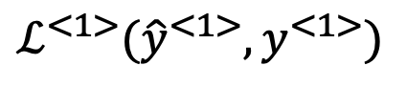
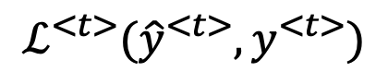







$$ℒ\left(\hat{y},y\right)$$
$$ℒ^{<1>}({\hat{y}}^{<1>},y^{<1>})$$
$$…$$
$$ℒ^{<t>}({\hat{y}}^{<t>},y^{<t>})$$
$${\hat{y}}^{<1>}$$
$${\hat{y}}^{<2>}$$
$${\hat{y}}^{<3>}$$
$${\hat{y}}^{<T_{y}>}$$
$$w_{ya}$$
$$w_{ya}$$
$$w_{ya}$$
$$w_{ya}$$
$$\frac{∂ℒ}{∂w_{a}}=\sum_{i=0}^{t}{\frac{∂ℒ^{<i>}}{∂w_{a}}}∝$$
$$\sum_{i=0}^{t}{\left(\prod_{i=k+1}^{T_{y}}{\frac{∂a^{<i>}}{∂a^{<i−1>}}}\right)\frac{∂a^{<k>}}{∂w_{a}}}$$
$$a^{<0>}$$
$$a^{<1>}$$
$$a^{<2>}$$
$$a^{<3>}$$
$$a^{<t−1>}$$
$$a^{<t>}$$
$$…$$
$$w_{aa}$$
$$w_{aa}$$
$$w_{aa}$$
$$w_{aa}$$
$$w_{ax}$$
$$w_{ax}$$
$$w_{ax}$$
$$w_{ax}$$
$$x^{<1>}$$
$$x^{<2>}$$
$$x^{<3>}$$
$$x^{<T_{x}>}$$
$ℒ^{<t>}\left({\hat{y}}^{<t>},y^{<t>}\right)=−y^{<t>}log{\hat{y}}^{<t>}−(1−y^{<t>}$) $log{(1−\hat{y}}^{<t>})$
$$ℒ\left(\hat{y},y\right)=\sum_{t=1}^{t}{ℒ^{<t>}({\hat{y}}^{<t>},y^{<t>})}$$
Backpropagation through time
Notes:
First, let's go through the forward propagation calculation. .....in order to compute backpropagation, you need a loss function. So let's define an element-wise loss force, which is supposed for a certain word in the sequence. It is a person's name, so y_t is one. And your neural network outputs some probability of maybe 0.1 of the particular word being a person's name. So we can define this as the standard logistic regression loss, also called the cross entropy loss. So this is the loss associated with a single prediction at a single position or at a single time set, t, for a single word. Let's now define the overall loss of the entire sequence, so L will be defined as the sum overall t. To compute the overall loss, we will take these and sum them all up to compute the final L, which is the sum of the individual per timestep losses. So, all of the forward propagation steps arrows, compute the overall loss. And then, it allows you to compute propogate back and update the parameters using gradient descent. Now, in this back propagation procedure, the most significant message or the most significant recursive calculation is this one, which goes from right to left, and that's why it gives this algorithm as well, a pretty fast full name called backpropagation through time. And the motivation for this name is that for forward prop, you are scanning from left to right, increasing indices of the time, t, whereas, the backpropagation, you're going from right to left, you're kind of going backwards in time. So this gives a really cool name, backpropagation through time, where you're going backwards in time, so far, you've only seen this one example in RNN, in which the length of the input sequence was equal to the length of the output sequence. I will introduce a much wider range of RNN architecture, which allow us to tackle a much wider set of applications.
The training of RNN is not trivial, as we backpropagate gradients through layers and also through time. Hence, in each time step we have to sum up all the previous contributions until the current one.
Now, so far, you've only seen this main motivating example in RNN, in which the length of the input sequence was equal to the length of the output sequence.
Next let see a much wider range of RNN architecture,

Slide 16
























Many to many, $T_{x}=T_{y}$
Many to one, $T_{x}≥0, { T}_{y}=1$
$${\hat{y}}^{<1>}$$
$${\hat{y}}^{<2>}$$
$${\hat{y}}^{<t>}$$
$${\hat{y}}^{<t>}$$
0/1 or 1-5
…
…
$$a^{<0>}$$
$$x^{<1>}$$
$$x^{<2>}$$
$$x^{<t>}$$
$$x^{<1>}$$
$$x^{<2>}$$
$$x^{<t>}$$
Name entity recognition
Review Sentiment classification
One to many
Many to many, $T_{x}≠T_{y}$
$${\hat{y}}^{<1>}$$
$${\hat{y}}^{<2>}$$
$${\hat{y}}^{<t>}$$
Encoder
$${\hat{y}}^{<1>}$$
$${\hat{y}}^{<t>}$$
…
…
…
$$a^{<0>}$$
$$a^{<0>}$$
Decoder
$$x^{<1>}$$
$$x^{<1>}$$
$$x^{<t>}$$
Music generation
Translation
Notes:
in name entity recognition, in the example we're using, the input length and the output length are identical,
in movie sentiment classification, the input can be different length or even empty and the output y could be just an integer from 1 to 5, whereas the input is a sequence
They're both input and output are sequences but have different lengths, such as machine translation where a French sentence and English sentence can mean two different numbers of words to say the same thing.
one-to-many neural network architecture will be music generation. And the input x could be just an integer, telling it what genre of music you want or what is the first note of the music you want, you can have this input a(0) as well. when you're actually generating sequences, often you take these first synthesized output and feed it to the next layer as well.
many-to-many Tx != Ty For an application like machine translation, the number of words in the input sentence, say a French sentence, and the number of words in the output sentence English, those sentences could be different lengths. this that collinear network architecture has two distinct parts. There's the encoder which takes as input, and then,a decoder, outputs the translation into a different language.
So it turns out that we could modify the basic RNN architecture to address all of these problems.

Slide 17

Speech recognition
The potato and pea curry
The potato and pee curry.
$P\left(The potato and pea curry\right)=3.7 × {10}^{−9}$
$P\left(The potato and pee curry\right)=1.2 × {10}^{−16}$
$P\left(y^{<1>},y^{<2>}…y^{<T_{y}>}\right)$
Training set: Large corpus of text (like wiki page etc)
“Caterpillars have soft bodies”
Notes:
The two sentences are sounds exactly the same, You probably think the first sentence is much more likely. In fact, that's what a good speech recognition system would output, even though these two sentences sound exactly the same. The way a speech recognition system picks the first sentence is by using a language model which tells it what is the probability of either of these two sentences.
How do you build a language model? To build such a model using a RNN, you will first need a training set comprising a large corpus of English text or text from whatever language you want to build a language model of.

Slide 18
Basic Transformations
Tokenization is the process of breaking down a text into words.
Stemming is a crude way of chopping of an end to get base word and often includes removal of derivational affixes. A derivational affix is an affix by means of which one word is formed (derived) from another. The derived word is often of a different word class from the original. Example: Hexagon, Hexa- means six
Lemmatization performs vocabulary and morphological analysis of the word and is normally aimed at removing inflectional endings only. An inflectional ending is a group of letters added to the end of a word to change its meaning. Some inflectional endings are: -s. bat. bats.
Notes:
As mentioned earlier, for a machine to make sense of natural language( language used by humans) it needs to be converted into some sort of a mathematical framework which can be modeled.

Slide 19
Language modelling with RNN
First, tokenize: form a vocabulary dictionary and then map each of these words to one-hot vectors.
Add extra token for EOS (End Of Sentence)
For unknow words which is not in your dictionary, then make UNK as taken for such words.
Next, take the input sentence and map to the individual tokens in your vocabulary
Notes:
Tokenization is the process of breaking down a text into words.

Slide 20

















Caterpillars have soft bodies.
$$p\left(y^{<1>},y^{<2>},y^{<3>}\right)=p\left(y^{<1>}\right).p\left(y^{<2>} | y^{<1>}\right).p(y^{<3>}|y^{<1>}y^{<2>})$$
$$p\left(word in dic\right)$$
P(a), p(middle), p(zulu)…
$$p(have|Caterpillars)$$
$$p(soft|Caterpillars have)$$
$${\hat{y}}^{<1>}$$
$${\hat{y}}^{<2>}$$
$${\hat{y}}^{<3>}$$
$$p(EOS|…)$$
Softmax
$$a^{<0>}$$
$$a^{<1>}$$
…
$$\overset{⃑}{0}$$
$x^{<1>}$= $\overset{⃑}{0}$
$$x^{<2>}=y^{<1>}$$
$$x^{<3>}=y^{<2>}$$
$x^{<5>}=y^{<4>}$(bodies)
Caterpillars
have
$$ℒ^{<t>}\left({\hat{y}}^{<t>},y^{<t>}\right)=−\sum_{i}{y_{i}^{<t>}}log{\hat{y}}_{i}^{<t>}$$
Softmax Loss function
$$ℒ\left(\hat{y},y\right)=\sum_{t=1}^{t}{ℒ^{<t>}({\hat{y}}^{<t>},y^{<t>})}$$
$a^{<t>}=g(w_{aa}a^{<t−1>}+w_{ax}x^{<t>}+b_{a}$)
${\hat{y}}^{<t>}=f(w_{ya}a^{<t>}+b_{y})$
Notes:
At time zero, you're going to end up computing some activation a_1 as a function of some input x_1, and x_1 would just be set to zero vector. The previous a_0 by convention, also set that to vector zeros. what a_1 does is it will make a Softmax prediction to try to figure out what is the probability of the first word y, so that's going to be y_1. it has a Softmax, so it's trying to predict what is the probability of any word in a dictionary, what's the chance that the first word is a, what's the chance that the first word is Aaron, and then what's the chance that the first word is cats, all the way up to what's the chance the first word is Zulu, Y hat 1 is output according to a Softmax, it just predicts what's the chance that the first word being whatever it ends up being.
in the next step.itis to try to figure out what is the second word. But now we will also give it the correct first word. the first word was actually catapilla, This is why y_1 is equal to x_2. At the second step, the output is again predicted by Softmax

Slide 21


Generate novel sequences
$${\hat{y}}^{<1>}$$
$${\hat{y}}^{<2>}$$
$${\hat{y}}^{<3>}$$
$$a^{<0>}$$
$$a^{<1>}$$
…
$x^{<1>}$= $\overset{⃑}{0}$
$$x^{<2>}={\hat{y}}^{<1>}$$
$$x^{<3>}={\hat{y}}^{<2>}$$
Notes:
You can keep sampling until you've hit the end of a sentence and you can stop. Or alternatively, if you do not include this in your vocabulary then you can also just decide to sample 20 words or 100 words or something

Slide 22















Vanishing Gradients problem in RNNs
The boy, who ………, was …..
The boys, who …….., were ….
$${\left\|\frac{∂a^{<i>}}{∂a^{<i−1>}}\right\|}_{2}>1 Exploding$$
$$\frac{∂ℒ}{∂w_{aa}}=\sum_{i=0}^{t}{\frac{∂ℒ^{<i>}}{∂w_{aa}}}∝\sum_{i=0}^{t}{\left(\prod_{i=k+1}^{T_{y}}{\frac{∂a^{<i>}}{∂a^{<i−1>}}}\right)\frac{∂a^{<k>}}{∂w_{aa}}}$$
$${\left\|\frac{∂a^{<i>}}{∂a^{<i−1>}}\right\|}_{2}<1 Vanishing$$
$${\hat{y}}^{<1>}$$
$${\hat{y}}^{<2>}$$
$${\hat{y}}^{<t−1>}$$
$${\hat{y}}^{<t>}$$
$$a^{<0>}$$
$$a^{<1>}$$
$$…$$
$$…$$
$$x^{<1>}$$
$$x^{<2>}$$
$$x^{<t−1>}$$
$$x^{<t>}$$
Notes:
the basic RNN we've seen so far is not very good at capturing very long-term dependencies because of gradient vanishing.
For an RNN we have forward prop going from left to right and then backprop going from right to left. It can be quite difficult because of the vanishing gradients problem for the outputs of the errors associated with the later time steps to affect the computations that are earlier. In practice, what this means is it might be difficult to get a neural network to realize that it needs to memorize. Did you see a singular noun or a plural noun so that later on in the sequence it can generate either was or were, depending on whether it was singular or plural. Notice that in English the yellow highlighted in the middle could be arbitrarily long. You might need to memorize the singular plural for a very long time before you get to use that bit of information. Because of this problem, the basic RNN model has many local influences, meaning that the output y hat of green is mainly influenced by values close to y hat of green and a value here is mainly influenced by inputs that are somewhat close. It's difficult for the output here to be strongly influenced by an input that was very early in the sequence. This is because whatever the output is, it's just very difficult for the error to backpropagate all the way to the beginning of the sequence, and therefore to modify how the neural network is doing computations earlier in the sequence
It turns out that exploding gradients are easier to spot because the parameter has just blow up. You might often see NaNs, not a numbers, meaning results of a numerical overflow in your neural network computation. If you do see exploding gradients, one solution to that is apply gradients clipping. All that means is, look at your gradient vectors, and if it is bigger than some threshold, re-scale some of your gradient vectors so that it's not too big, so that is clipped according to some maximum value. If you see exploding gradients, just apply gradient clipping. That's a relatively robust solution that will take care of exploding gradients. But vanishing gradients is much harder to solve

Slide 23
Solutions for vanishing gradient problem
Using ReLU activation function.
Gated Recurrent Unit (GRU)
Long-Short Term Memory (LSTM)
Initialize the weight matrix, W, with an orthogonal matrix, use it for the entire training (multiplications of orthogonal matrices doesn’t explode or vanish).
Notes:
the gated recurrent unit, which has a modification to the RNN hidden layer that makes it much better at capturing long-range connections and helps a lot with the vanishing gradient problems.

Slide 24










Gated Recurrent Unit (GRU)
RNN
$$y^{<t>}$$
softmax
$$y^{<t>}$$
$$a^{<t−1>}$$
Tanh
$$a^{<t>}$$
Update Gate
$$a^{<t>}$$
$$a^{<t−1>}$$
$$x^{<t>}$$
$a^{<t>}=g(w_{aa}a^{<t−1>}+w_{ax}x^{<t>}+b_{a}$)
${\hat{y}}^{<t>}=f(w_{ya}a^{<t>}+b_{y})$
or
Reset Gate
$$h^{<t−1>}$$
$$x^{<t>}$$
Update gate: how much of pass memory to retain
Reset gate: how much of pass memory to forget
Pandas, one of the world's most fascinating vegetarians, their specific diet is almost nothing but bamboo shoots and leaves. Koalas, the only extant representative of….., their diet…..eucalyptus leaves.
2014 by Kyunghyun Cho et al On the Properties of Neural Machine Translation: Encoder-Decoder Approaches

Slide 25






Gated Recurrent Unit (GRU)
Reset Gate
$$u^{r}$$
$$r^{<t>}$$
$$h^{<t−1>}$$
Sigmoid
Forget Panda
$$w^{r}$$
$$x^{<t>}$$
$$r^{<t>}=σ\left(w_{r}x^{<t>}+U_{r}h^{<t−1>}\right)$$
Pandas, one of the world's most fascinating vegetarians, their specific diet is almost nothing but bamboo shoots and leaves. Koalas, the only extant representative of….., their …..eucalyptus leaves.

Slide 26


GRU

Slide 27



Gated Recurrent Unit (GRU)
Hadamard product
Source: Wikipedia
Update gate: $z_{t},$ Reset gate: $r_{t}$
When $z_{t}≈0, h_{t}=h_{t−1}$, there if prevent from gradient vanishing problem
Cho et al. 2014 On the Properties of Neural Machine Translation: Encoder-Decoder Approaches
Chung et al. 2014 Empirical Evaluation of Gated Recurrent Neural Networks on Sequence Modeling
Notes:
Reset gate is help to remember how relevant of h_t-1 is to h hat t,
What these element-wise multiplications do is it just tells you GRU which are the dimensions of your memory cell vector to update at every time step. You can choose to keep some bits constant while updating other bits. For example, maybe you'll use one-bit to remember the singular or plural, and maybe you'll use some other bits to realize that you're talking about food.
As you can imagine, there are multiple ways to design these types of neural networks. It turns out that over many years, researchers have experimented with many different possible versions of how to design these units to try to have longer range connection and also address vanishing gradient problems. The GRU is one of the most commonly used versions that researchers have converged to and then found as robust and useful for many different problems. If you wish, you could try to invent a new versions of these units The other common version is called an LSTM,

Slide 28









Long Short-term Memory (LSTM)
Source: Wikipedia
Forget
$$f^{<t>}$$
Input
$$i^{<t>}$$
$${\tilde{c}}^{<t>}$$
Output $o^{<t>}$
$$h_{t} equavalents to a_{t}$$
3 Gates: Input, output, forget
More accurate on longer sequence, less efficient
Hochreiter & Schmidhuber 1997, Long Short-Term Memory

Slide 29





LSTM
$$c^{<1>}$$
$$c^{<2>}$$
$$c^{<3>}$$
$$c^{<0>}$$
LSTM
GRU
Invented: 1997
3 Gates: Input, output, forget
More accurate on longer sequence, less efficient
Invented: 2014
2 Gates: Reset, update
More efficient computation wise
Notes:
So you can take these units and just hook them up And one cool thing about this, you notice is that this is a line at the top that shows as long as you set the forget and the update gates, appropriately, it is relatively easy for the LSTM to have some value C0 and have that be passed all the way to the right, maybe C3 equals C0. And this is why the LSTM as well as the GRU is very good at memorizing certain values. Even for a long time for certain real values stored in the memory cells
LSTMs actually came much earlier than GRUs. Researchers have tried both of these models on many different problems the different algorithms will win out. So there isn't a universally superior algorithm. the advantage of the GRU is that it's a simpler model. And so it's actually easier to build a much bigger network only has two gates, so computation runs a bit faster. it scales the building of bigger models. But the LSTM is more powerful and more flexible since there's three gates instead of two. more and more teams are also using GRUs because they're a bit simpler easier to scale them to even bigger problems.

Slide 30


















Bidirectional RNN
It is his right hand got injured.
It is his right to keep silent.
Unidirectional or forward directional only RNN.
$${\hat{y}}^{<1>}$$
$${\hat{y}}^{<2>}$$
$${\hat{y}}^{<3>}$$
$${\hat{y}}^{<4>}$$
$${\hat{y}}^{<5>}$$
$${\hat{y}}^{<6>}$$
$${\hat{y}}^{<7>}$$
$$a^{<0>}$$
$$a^{<1>}$$
$$a^{<2>}$$
$$a^{<4>}$$
$$a^{<5>}$$
$$a^{<6>}$$
$$a^{<7>}$$
$$a^{<3>}$$
RNN, GRU, LSTM etc
$$x^{<1>}$$
$$x^{<2>}$$
$$x^{<3>}$$
$$x^{<4>}$$
$$x^{<5>}$$
$$x^{<6>}$$
$$x^{<7>}$$
It is his right to keep silent.
Notes:
one of the problems of unidirectional or forward directional RNN is that, to figure out whether the fourth word “right” is legal entitlement or left right’s right. it's not enough to just look at the first part of the sentence. you need more information than just the first few words. Bidirectional RNN lets you at the point in time to take information from both earlier and later in the sequence

Slide 31

















Bidirectional RNN
${\hat{y}}^{<t>}=g(w_{y}[{\vec{a}}^{<t>},$ ${\overset{⃐}{a}}^{<t>}]+b_{y})$
$${\hat{y}}^{<1>}$$
$${\hat{y}}^{<2>}$$
$${\hat{y}}^{<3>}$$
$${\hat{y}}^{<4>}$$
$${\vec{a}}^{<1>}$$
$${\overset{⃐}{a}}^{<1>}$$
$${\vec{a}}^{<2>}$$
$${\overset{⃐}{a}}^{<2>}$$
$${\vec{a}}^{<3>}$$
$${\overset{⃐}{a}}^{<3>}$$
$${\vec{a}}^{<4>}$$
$${\overset{⃐}{a}}^{<4>}$$
RNN, GRU, LSTM etc
$$x^{<1>}$$
$$x^{<3>}$$
$$x^{<4>}$$
$$x^{<2>}$$
Acyclic graph
Cons: need the entire sequence of data before you can make predictions anywhere
Notes:
So notice that this network defines a cyclic draft. Given an input sequence X1 to X4, the four sequence we first compute a for (1), then use that to compute a for (2), then a for (3), then a for (4). Whereas the backward sequence will start by computing a backward four and then go back and compute a backward three. And notice your computing network activations. This is not backpropagation. This is forward propagation which has part of the computation going from left to right and part of the computation going from right to left in this diagram. You can then use those activations completely backward two, and then a backward one. And then finally, you haven't computed all your hidden layer activations. You can then make your predictions. And so for example, to make the predictions your network would have something like y hat at time T is an activation function apply to WY with both the forward activation at time T. And the backward activation at time T being fed in, to make that prediction at time T. for example prediction at time point 3, it takes input both information from the past, as well as information from the future.
And these blocks here can be the standard RNN block, they can also be GRU blocks, or LSTM blocks.

Slide 32
























Deep RNNs
$$a^{\left[2\right]<2>}=g(w_{a}^{\left[2\right]}\left[a^{\left[2\right]<1>},a^{\left[1\right]<2>}\right]+b_{a}^{[2]})$$
$$y^{<1>}$$
$$y^{<2>}$$
$$y^{<3>}$$
$$y^{<4>}$$
$$a^{\left[3\right]<0>}$$
$$a^{\left[3\right]<1>}$$
$$a^{\left[3\right]<2>}$$
$$a^{\left[3\right]<3>}$$
$$a^{\left[3\right]<4>}$$
$$a^{\left[2\right]<0>}$$
$$a^{\left[2\right]<1>}$$
$$a^{\left[2\right]<2>}$$
$$a^{\left[2\right]<3>}$$
$$a^{\left[2\right]<4>}$$
$$a^{\left[1\right]<0>}$$
$$a^{\left[1\right]<1>}$$
$$a^{\left[1\right]<2>}$$
$$a^{\left[1\right]<3>}$$
$$a^{\left[1\right]<4>}$$
[Layer],<time>
$$x^{<1>}$$
$$x^{<2>}$$
$$x^{<3>}$$
$$x^{<4>}$$
Notes:
Let’s look at an example of how this value is computed. So a[2] <2> has two inputs. It has the input coming from the bottom, and there's the input coming from the left. the same parameters Wa[2] and ba[2] are used for every one of these computations at this layer. the same parameters Wa[2] and ba[2] are used for every one of these computations at this layer
we've seen neural networks that are very, very deep, maybe over 100 layers.
For RNNs, having three layers is already quite a lot. Because of the time point dimension, these networks can already get quite big even if you have just a small handful of layers.
you may have recurrent layers that are stacked on top of each other. But then you might t add a bunch of deep layers that are not connected horizontally but have a deep network that then finally predicts y<1>.

Slide 33












Word Embedding
$${\hat{y}}^{<1>}$$
$${\hat{y}}^{<2>}$$
$${\hat{y}}^{<3>}$$
$${\hat{y}}^{<4>}$$
$${\hat{y}}^{<5>}$$
$${\hat{y}}^{<6>}$$
$${\hat{y}}^{<7>}$$
$$a^{<0>}$$
$$a^{<1>}$$
$$a^{<2>}$$
$$a^{<4>}$$
$$a^{<5>}$$
$$a^{<6>}$$
$$a^{<7>}$$
$$a^{<3>}$$
$$x^{<1>}$$
$$x^{<2>}$$
$$x^{<3>}$$
$$x^{<4>}$$
$$x^{<5>}$$
$$x^{<6>}$$
$$x^{<7>}$$
Tim bought the apple and orange juice.
6469
1205
6231
235
201
3924
2039
Vocabulary: [a, aardvark, …Zyzzyva]
1-hot representation
$$\left[\begin{matrix}0 \\ 0.05 \\ \begin{aligned}0.17 \\ 0.80 \\ 0.01 \\ ⋮\end{aligned}\end{matrix}\right]$$
$$\left[\begin{matrix}0 \\ 0.89 \\ \begin{aligned}0. \\ 0 \\ 0.01 \\ ⋮\end{aligned}\end{matrix}\right]$$
$$\left[\begin{matrix}0 \\ 0.04 \\ \begin{aligned}0.16 \\ 0.81 \\ 0.01 \\ ⋮\end{aligned}\end{matrix}\right]$$
$$\left[\begin{matrix}0 \\ 0 \\ \begin{aligned}0 \\ 1 \\ ⋮\end{aligned}\end{matrix}\right]$$
$$\left[\begin{matrix}0 \\ 1 \\ \begin{aligned}0 \\ 0 \\ ⋮\end{aligned}\end{matrix}\right]$$
$$\left[\begin{matrix}0 \\ 0 \\ \begin{aligned}0 \\ 1 \\ ⋮\end{aligned}\end{matrix}\right]$$
Notes:
today we are going to talk about how you can convert words into numbers when you are dealing with any natural language processing task, your input is text and machine learning models can't understand text so you have to get it converted into a number.
First, you build a vocabulary which is a list of words. For example 10,000 words. you can assign unique number to each words. and then you can use those numbers as an input to your RNN. But there are issues such as the numbers are random they don't capture the relationship between two words for example apples and oranges are both fruits. so maybe these numbers should be similar so these kind of random numberings cannot capture the similarities between the words so then the second option you have is one hot encoding, which is basically you take all your words, you get a vector for each word. 1 at the position of dictionary, 0 at other place. Apple, [0100000..]
Obviously they don't capture the relationship. if you are just looking at the vectors, you can't tell if two words are similar. like banana and grapes for example these are the two fruits so if you have these two fruits maybe you want their vectors to be little similar. the second problem is it is computationally inefficient if your vocabulary has 10,000 words for each word you get a vector whose size is 10,000.
so the third option you have is using word embeddings. Word embeddings allow you to capture relationship between the two words. Let's see how do you capture similarities between two words.

Slide 34

Feature representation
 | King | Queen | Man | Woman | Orange | Apple
Gender | -1 | 1 | -1 | 1 | 0 | 0.001
Authority | 1 | 1 | 0.1 | 0.095 | 0 | 0
Food | 0 | 0 | 0 | 0 | 0.99 | 0.995
shape | 0.3 | 0.29 | 0.29 | 0.28 | 0.7 | 0.71
… | … | … | … | … | … | …
Convert words into vectors that have semantic and syntactic meanings.
vector(”King”)-vector(”Man”)+vector(”Woman”) =vector(”Queen”)
$\left[\begin{aligned}−1 \\ 1 \\ 0 \\ 0.3\end{aligned}\right]−$ $\left[\begin{aligned}−1 \\ 0.1 \\ 0 \\ 0.29\end{aligned}\right]+\left[\begin{aligned}1 \\ 0.095 \\ 0 \\ 0.28\end{aligned}\right]=\left[\begin{aligned}1 \\ 0.995 \\ 0 \\ 0.29\end{aligned}\right]$
.

Slide 35


Word embedding
Tim bought the apple and orange juice.
O6469
O1205
O6231
O235
O201
O3924
O2039
One Hot vector
E E E E E E E
e6469
e1205
e6231
e235
e201
e3924
e2039
$$W^{[1]},b^{[1]}$$
Softmax
$$W^{[2]},b^{[2]}$$
Bengio et al. 2003, A neural probabilistic language model
Notes:
you don't want to hand code all these properties for all these words let's say you're doing doing natural language processing for all the text on Wikipedia. there are so many millions of words and to come up with these kind of properties for each of these words will be very very difficult. so you don't want to hand craft it in computer programming. you can use neural networks to learn these feature vectors. these numbers are called feature vectors
If we have a vocabulary with size 10K, So this is going to be 10,000 dimensional vector. And what we're going to do is then have a matrix of parameters E, and take E times O to get an embedding vector

Slide 36


Visualize Word Embedding
T-SNE
Source Andrew NG
Notes:
If we're able to learn a 10K dimensional feature vector or 10K dimensional embedding for each words, one of the popular things to do is to embed it in a two dimensional space so that you can visualize them. And so, common algorithm like PCA or the t-SNE algorithm due to Laurens van der Maaten and Geoff Hinton.

Slide 37
Transfer learning with word embeddings
Learning word embeddings from large text corpus. (e.g. All the wiki pages, 100B words)
Transfer embeddings to new task with smaller training set.
Name entity recognition
Text summarization
Coreference resolution
Notes:
Step 1 is to learn word embeddings from a large text corpus, a very large text corpus or you can also download pre-trained word embeddings online. There are several word embeddings that you can find online under very permissive licenses. And you can then take these word embeddings and transfer the embedding to new task, where you have a much smaller labeled training sets. And use this, embedding, to represent your words.
one thing you can optionally do is to continue to fine tune, continue to adjust the word embeddings with the new data

Slide 38


Analogy reasoning
 | King | Queen | Man | Woman | Orange | Apple
Gender | -1 | 1 | -1 | 1 | 0 | 0.001
Authority | 1 | 1 | 0.1 | 0.095 | 0 | 0
Food | 0 | 0 | 0 | 0 | 0.99 | 0.995
shape | 0.3 | 0.29 | 0.29 | 0.28 | 0.7 | 0.71
… | … | … | … | … | … | …
$$e_{man}−e_{woman}≈e_{King}−?$$
Find word w: $\arg{\max{sim(e_{w}, e_{king}−e_{man}+e_{woman}}}$
Cosine Similarity. $sim\left(u,v\right)=\frac{u^{T}v}{{\left\|u\right\|}_{2}{\left\|v\right\|}_{2}}$
Notes:
So one way to carry out this analogy reasoning is, if the algorithm is asked, man is to woman as king is to what? What it can do is compute e man- e woman, and try to find a vector, try to find a word so that e man- e woman is close to e king- e of that new word. And it turns out that when queen is the word plugged in here, then the left hand side is close to the the right hand side. So these ideas were first pointed out by Tomas Mikolov, Wen-tau Yih, and Geoffrey Zweig. And it's been one of the most remarkable and surprisingly influential results about word embeddings.
the most commonly used similarity function is called cosine similarity. So this is the equation. in cosine similarity, you define the similarity between two vectors u and v as u transpose v divided by the lengths by the Euclidean lengths. So ignoring the denominator for now, this is basically the inner product between u and v. And so if u and v are very similar, their inner product will tend to be large. And this is called cosine similarity because this is actually the cosine of the angle between the two vectors, u and v.
if the angle between them is 0, then the cosine similarity is equal to 1. And if their angle is 90 degrees, the cosine similarity is 0. And then if they're 180 degrees, or pointing in completely opposite directions, it ends up being -1. So that's where the term cosine similarity comes from, and it works quite well for these analogy reasoning tasks. So one of the remarkable results about word embeddings is the generality of analogy relationships they can learn. So for example, it can learn that man is to woman as boy is to girl, because the vector difference between man and woman, similar to king and queen and boy and girl, is primarily just the gender. It can learn that Ottawa, which is the capital of Canada, that Ottawa is to Canada as Nairobi is to Kenya. So that's the city capital is to the name of the country. It can learn that big is to bigger as tall is to taller, and it can learn things like that. Yen is to Japan, since yen is the currency of Japan, as ruble is to Russia.

Slide 39
Word embedding milestones
2005 Morin and Bengio come up with the idea of hierarchical softmax.
2012: Gutmann and Hyvarinen introduce Noise Contrastive Estimation (NCE)
2013 Jan. Mikolov et al. develop word2vec
2013 Oct. Mikolov et al. improve on their earlier models by proposing negative sampling.
2019 Jan. Alon et al. produce code embeddings, vector representations of snippets of software code called code2vec
2019 June. Li et al. Scaling word2vec using multiple GPUs.

Slide 40
Word2Vector
Convert words into vectors that have semantic and syntactic meanings.
vector(”King”)-vector(”Man”)+vector(”Woman”) =vector(”Queen”).
CBOW (Continuous Bag-of-Words): Predicts missing word from its previous and future words
Skip-Gram: predicts missing words that surrounding the current word.
The real goal is to produce word embeddings that can be used in NLP tasks.
We are essentially trying to do is to capture word co-occurrences, but one sliding window at a time.
Mikolov et. Al 2013. Efficient estimation of word representations in vector space
Notes:
The goal that's setting up this supervised learning problem, isn't to do well on the supervised learning problem per se, it is that we want to use this learning problem to learn good word embeddings.
That's your fake problem, well the problem is real, but our goal is not to learn what is the missing word in a sentence our goal is to learn word embedding

Slide 41


COBW(Continuous Bag-of-Words) model
Take words surrounding a given word and try to predict the latter.
Vocabulary of V words, a context of C words
Embedding matrix $W ε ℝ^{V× N}$
Context matrix $W′ ε ℝ^{N× V}$
At the input layer, each word is one-hot coded. 1 $×$ V dimension
NASA launched______ last week..
Tree, Apple, Rocket, beautiful,….
Source: Rong 2016
Context word, target words
Notes:
Word2vec is not a deep learning technique. In fact, there are no hidden layers, although it's common to refer to the embedding layer as hidden layer, or projection layer. A typical pipeline involves selecting the vocabulary from a text corpus, sliding the window to select context, performing extra tasks to simplify softmax computation, and iterating through the neural network model.

Slide 42


Skip-gram model
We take one word and try to predict words that occur around it.
At the output, we try to predict C different words.
NASA launched last month
Yet Harry Potter was still there, asleep at the moment, but not for long. His Aunt Petunia was awake and it was her shrill voice that made the first noise of the day.
$$ℒ\left(\hat{y},y\right)=−\sum_{i=1}^{v}{y_{i},log\hat{y_{i}}}$$
Context word, target words
Notes:
Consider the skip-gram model. A sliding window around the current input word is used to predict the words within the window. Once this iteration adjusts the weights, the window slides to the next word in the corpus.
Corpus means a collection of written texts, especially the entire works of a particular author or a body of writing on a particular subject
The skip-gram model is taking as input one word like “asleep” and then trying to predict some words skipping a few words from the left or the right side. To predict what comes little bit before little bit after the context words.

Slide 43



A vocabulary of K words
Parellada, Antoni. 2017
Notes:
The softmax layer treats the problem of selecting the most probable word as a multiclass classification problem. It computes the probability of each word being the actual word. Probabilities of all words should add up to 1。 For skip-gram model, it does this for each contextual word。Consider a vocabulary of K words, and input and output vectors vw and v′w of word w. For skip-gram, softmax function is the probability of an output word given the input word, With a vocabulary of hundreds of thousands of words, computing the softmax probability for each word for each iteration is computationally expensive. Especially to sum up the denominator.

Slide 44
Problems With CBoW/Skip-gram
The weights corresponding to the target word might get a significant update.
The weight corresponding to non-target words would receive a marginal or no change.
The calculation of the final probabilities using the softmax is an expensive operation as it involves a summation of scores over all the words in our vocabulary for normalizing.
we should reduce the number of weights updated for each training sample.
Notes:
we are performing an expensive operation to calculate the probability for words whose weight might not even be updated or be updated so marginally that it is not worth the extra overhead.

Slide 45


Hierarchical softmax
Computational complexity: $O\left(v\right)→O(\log_{2}v)$
Notes:
Hierarchical Softmax solves this problem by doing computations on word parts and reusing the results. there are a few solutions to this, one which you see in the literature is to use a hierarchical softmax classifier. And what that means is, instead of trying to categorize something into all 10,000 vocabulary words on one go. Imagine if you have one classifier, it tells you is the target word in the first 5,000 words in the vocabulary? Or is in the second 5,000 words in the vocabulary? And let's say this binary cost that it tells you this is in the first 5,000 words, think of second class to tell you that this in the first 2,500 words of vocab or in the second 2,500 words vocab and so on. So this is called a hierarchical softmax classifier. I should mention in practice, the hierarchical softmax classifier doesn't use a perfectly balanced tree or perfectly symmetric tree, with equal numbers of words on the left and right sides of each branch. In practice, the hierarchical software classifier can be developed so that the common words tend to be on top, whereas the less common words can be buried much deeper in the tree. Because you see the more common words more often, and so you might need only a few traversals to get to common words like the and of. Whereas you see less frequent words much less often, so it says okay that are buried deep in the tree because you don't need to go that deep. So there are various heuristics for building the tree how you used to build the hierarchical software spire.

Slide 46


Negative Sampling
Turn the problem of giant softmax (classifying among 10k classes into binary classification problem.
Change the problem of P(juice|orange) to P(1|<orange, juice>)
“This batch of orange juice is produced from Florida.”
Input $x$
Sample a small number k(a hyper-parameter) of random words as “negative” words.
The loss will only be propagated back to juice and k negative words
Context
Orange
Orange
Orange
Orange
Orange
….
Word
Juice
Dinner
Strange
Dog
up
….
Output $y$
1
0
0
0
0
….
Context word, target words
Mikolov et al. 2013 Distributed representation of words and phrase and their compositionality
Notes:
a “negative” word is one for which we want the network to output a 0
How do you choose k, Mikolov et al, recommend that maybe k is 5 to 20 for smaller data sets. And if you have a very large data set, then chose k to be smaller. So k equals 2 to 5 for larger data sets, and large values of k for smaller data sets

Slide 47




How to sample negative words
$p\left(w_{i}\right)$ by word frequency?
1/v ?
$p\left(w_{i}\right)=U\left(w\right)=\frac{f{\left(w_{i}\right)}^{3/4}}{\sum_{j=0}^{n}{(f{\left(w_{j}\right)}^{\frac{3}{4}})}}$
P(orange) = 10/14 =0.71
P(apple) = 3/14 = 0.21
P(banana) = 1/14 = 0.07
Notes:
One thing you could do is sample it according to the empirical frequency of words in your corpus. So just sample it according to how often different words appears. But the problem with that is that you end up with a very high representation of words like the, of, and, and so on. One other extreme would be to say, you use 1 over the vocab size, sample the negative examples uniformly at random, but that's also very non-representative of the distribution of English words. So the authors, Mikolov et al, reported that empirically, what they found to work best was to take this heuristic value, which is a little bit in between the two extremes of sampling from the empirical frequencies, meaning from whatever's the observed distribution in English text to the uniform distribution. And what they did was they sampled proportional to their frequency of a word to the power of three-fourths. So if f of wi is the observed frequency of a particular word in the English language or in your training set corpus, then by taking it to the power of three-fourths, this is somewhere in-between the extreme of taking uniform distribution. And the other extreme of just taking whatever was the observed distribution in your training set.
P(w) = U(w) raised to the 3/4 power, where U(w) is a unigram distribution. The 3/4 power makes less frequent words be sampled more often, without it probability of sampling frequent words such as “the”, “is” etc would be much higher than words like “zebra”, “elephant” etc.
For example, we have a bag including 3 apples, 10 oranges and 1 banana. If we pick 1 fruit from bag, the probability of orange is 0.71 (10/14), apple is 0.21 (3/14), banana is 0.07 (1/14).
Since we do not want to pick a high frequency words all the time as those words usually provide less value than rare words. The apply the power of 3/4 to the probability can solve this problem. For example, the probability of orange is 0.71 which is converted to 0.77 while banana’s probability is converted from 0.07 to 0.14. In that cases, the probability of banana is doubled.

Slide 48

GLoVe: Global Vectors for word representation
GLoVe: hybrid of count based (word co-occurrence count globally) and window-based models
“Solid” “ice”; “gas”, “steam”
$q_{ij}=P\left(w_{j} | w_{i}\right)=\frac{exp⁡(u_{j}^{⊺}v_{i})}{\sum_{k∈v}{exp⁡(u_{k}^{⊺}v_{i})}}$ in skip-gram model
$𝒱=\left\{0,1,…,\left|𝒱\right|−1\right\}$ is the index set of the vocabulary
Multiplicity: same word may occur multiple times in the corpus. Use multiset $C_{i}$ for $w_{i}$ as center word in multiple places
$w_{i}$ may occurs twice in the following context windows
$k,j,m,k$ and $k,l,k,j$, so multiset $C_{i}=\{j,j,k,k,k,k,l,m\}$, where multiplicities of elements $j,k,l,m$ are 2, 4, 1, 1 respectively.
Denote the multiplicity of element j I multiset $C_{i}$ as $x_{ij}$, this is the global co-occurrence count of word $w_{j}$ (as context word) and $w_{i}$ (as the center word) in the same context window in the entire corpus
Notes:
Word-word co-occurrences within context windows may carry rich semantic information. For example, in a large corpus word “solid” is more likely to co-occur with “ice” than “steam”, but word “gas” probably co-occurs with “steam” more frequently than “ice”. Besides, global corpus statistics of such co-occurrences can be precomputed: this can lead to more efficient training.

Slide 49


GLoVe: Global Vectors for word representation
GLoVe: hybrid of count based (word co-occurrence count globally) and window based models
$$J\left(θ\right)=\frac{1}{2}\sum_{i,j=1}^{W}{f(x_{ij}){(u_{i}^{T}v_{j}−logx_{ij})}^{2}}$$
The goal is to minimize the difference between the inner product of their word embedding and the log count of i and j
f(Pij) allows us to weight lower some very frequent co-occurrences and cap the importance of very frequent words.
If $x_{ij}=0, f\left(x_{ij}\right)=0, 0log0=0$
Pennington et. Al., 2014 GloVe: Global vectors for word representation
Notes:
we capture the frequency of co occurrences in a matrix is count based model. by using window-based methods to learn our embedding, we are able to capture complex patterns that go beyond word similarity but we make inefficient use of statistics. By using purely count-based methods, we make efficient use of statistics but aren’t able to capture the complex underlying patterns which are very useful when we apply these embeddings to extrinsic tasks.
the weighting factor can be a function that gives a meaningful amount of computation, even to the less frequent words. It gives more weight but not an unduly large amount of weight to words like, this, is, of, a, which just appear lost in language
there are various heuristics for choosing this weighting function F that need or gives these words too much weight nor gives the infrequent words too little weight

Slide 50
GLoVe: Global Vectors for word representation
Fast training: Unlike window-based methods, where we used to optimize one window at a time (might train over the same co-occurrence multiple times), in GloVe we just optimize one count at a time.
Scalable: Rare words in a huge corpora don’t occur very often, but GloVe allows us to capture the semantics irrespective of the number of occurrences of a word.
Efficient use of statistics: It helps in the model performing well even on small corpus and small vector sizes.
https://medium.com/@jonathan-hui/nlp-word-embedding-glove-5e7f523999f6

Slide 51





Simple Sentiment Classification Model
$$o_{8828}$$
$o_{8212}$ $o_{4694}$
$$o_{2396}$$
$$e_{8828}$$
$e_{8212}$ $e_{4694}$
$$e_{2396}$$
The
Service
Is
excellent
E
E
E
E
Softmax
1-5
Average
$$\hat{y}$$
This company lacks good management, good customer service, and good product
Notes:
This is a very negative review, But the word good appears a lot. So if you use an algorithm that ignores word order and just sums or averages all of the embeddings for the different words, then you end up having a lot of the representation of good in your final feature vector and your classifier will probably think this is a good review even though this is actually very harsh.

Slide 52

Simple Sentiment Classification Model– Many to one RNN
$$\hat{y}$$
Softmax
$$a^{<0>}$$
$$a^{<1>}$$
$$…$$
$$…$$
$$x^{<1>}$$
$$x^{<2>}$$
$$x^{<t>}$$
$e_{8982}$ ${ e}_{822} { e}_{3767}$. …. $e_{6572}$
E E E E E
This company lacks good …. product
Notes:
take the one-hot vectors, multiply it by the embedding matrix E as usual, then this gives you the embedding vectors and then you can feed these into an RNN. And the job of the RNN is to then compute the representation at the last time step that allows you to predict Y-hat. So this is an example of a many-to-one RNN architecture. And with an algorithm like this, it will be much better at taking word sequence into account and realize that "things are lacking in good management…" is a negative review and "not good" a negative review unlike the previous algorithm, which just sums everything together into a big-word vector mush and doesn't realize that "not good" has a very different meaning than the words "good" or "lacking in good taste" and so on. And so if you train this algorithm, you end up with a pretty decent sentiment classification algorithm and because your word embeddings can be trained from a much larger data set, this will do a better job generalizing to maybe even new words now that you'll see in your training set, such as if someone else says, "without good sense " or something, then even if the word "not" is not in your label training set, if it was in your 1 billion more word corpus used to train the word embeddings, it might still get this right and generalize much better even to words that were in the training set used to train the word embeddings but not necessarily in the label training set that you had for specifically the sentiment classification problem.

Slide 53

Sequence to sequence model-Basic
Ich mag Vanilleeis.
I like vanilla ice cream.
Source: https://towardsdatascience.com/sequence-to-sequence-model-introduction-and-concepts-44d9b41cd42d
Sutskever et al., 2014 Sequence to sequence learning with neural networks
Cho et. Al., 2014 Learning phrase representations using RNN encoder-decoder for statistical machine translation
Notes:
https://github.com/ematvey/tensorflow-seq2seq-tutorials#1---simple-sequence-to-sequence-model-with-dynamic-unrolling
seq2seq model has encoder, decoder and intermediate step as its main components:
First, let's have a network which we're going to call the encoder network be built as a RNN and this could be a Gru or LSTM feeding the input German words one word at a time. After ingesting the input sequence the RNN then outputs a vector that represents the input sentence. After that, you can build a decoded network, which you might draw here. Which takes as input the encoding output by the encoding network, and then can be trained to output the translation one word at a time. Eventually, it helps us say the end of sequence and the sentence taken upon which the decoder stops, and as usual, we could take the generator tokens and feed them to the Knicks so if they just stay in the sequence they were doing before when synthesizing techs using the language model. One of the most remarkable recent results in deep learning is that this model works. Given enough pairs of English and German sentences, if you train a model to input a German sentence and output the corresponding English translation, this will actually work decently well. This model simply uses an encoding network whose job it is to find an encoding of the input German sentence, and then use a decoding network to then generate the corresponding English translation.

Slide 54




Machine translation as building a conditional language model
Language Model
Ich mag Vanilleeis.
$$x^{<2>}={\hat{y}}^{<1>}$$
I like vanilla ice cream.
Machine translation
$$p(y^{<1>},…,y^{<T_{y}>}|x^{<1>},…,x^{<T_{x}>})$$
Source: Andrew NG
Notes:
There are some similarities between the sequence to sequence machine translation model and the language models, but there are some significant differences as well. Let's take a look. A language modeling allows you to estimate the probability of a sentence. You can also use this to generate novel sentences, X1 could be the vector of all zeros and x2, x3 can be just the previous output you are generating. So that was the language model. The machine translation model looks as follows. The coded network is denoted in green and the decoded network is denoted in purple. And you notice that the decoded network looks pretty much identical to the language model that we had up there. So what the machine translation model is, is very similar to the language model, except that instead of always starting along with the vector of all zeros, it instead has an encoded network that figures out some representation for the input sentence, and it takes that input sentence and starts off the decoded network with representation of the input sentence rather than with the representation of all zeros. So, that's why I call this a conditional language model, and instead of modeling the probability of any sentence, it is now modeling the probability of, say, the output English translation, conditions on some input German sentence. So in other words, you're trying to estimate the probability of an English translation. Like, what's the chance that the translation is "I like vanilla ice cream" but conditions on the input German censors like, " Ich mag Vanilleeis." So, this is really the probability of an English sentence conditions on an input German sentence which is why it is a conditional language model. Now, if you want to apply this model to actually translate a sentence from German into English, given this input German sentence, the model might tell you what is the probability of difference in corresponding English translations. So, x is the German sentence, " Ich mag Vanilleeis." And, this now tells you what is the probability of different English translations of that German input. And, what you do not want is to sample outputs at random. If you sample words from this distribution, p of y given x, maybe one time you get a pretty good translation, "I like vanilla ice cream." But, maybe another time you get a different translation, "I like vanilla flavored ice cream. " Which sounds a little awkward but is not a terrible translation, just not the best one. And sometimes, just by chance, you get, say, others: "I like ice cream with vanilla flavor."
So, when you're using this model for machine translation, you're not trying to sample at random from this distribution. Instead, what you would like is to find the English sentence, y, that maximizes that conditional probability. So in developing a machine translation system, one of the things you need to do is come up with an algorithm that can actually find the value of y that maximizes this term over here. The most common algorithm for doing this is called beam search,

Slide 55

BEAM search
Greedy decoding: selects the best candidate conditional on input sequence for each output time step. For longer sentence it is sub-optimal
Beam search: selects multiple options conditional on input sequence at each timestep. Beam Width B decide the number of alternatives.
Source: https://towardsdatascience.com/the-three-decoding-methods-for-nlp-23ca59cb1e9d

Slide 56



Length normalization
$$\arg{\max_{y}{\prod_{t=1}^{T_{y}}{P(y^{<t>}|x, y^{<1>},…,y^{<t−1>})}}}$$
$p\left(y^{<1>},…,y^{<t−1>} | x\right)=p(y^{<1>}|x)$ $p\left(y^{<2>} | x,y^{<1>}\right)…p(y^{<t>}|x,y^{<1>},…,y^{<t−1>})$
$$\arg{\max_{y}{\sum_{t=1}^{T_{y}}{logP(y^{<t>}|x, y^{<1>},…,y^{<t−1>})}}}$$
$$\arg{\max_{y}\frac{1}{T_{y}^{α}}{\sum_{t=1}^{T_{y}}{logP(y^{<t>}|x, y^{<1>},…,y^{<t−1>})}}}$$
Notes:
we talked about beam search as maximizing this probability and this product here is just expressing the observation that p of y1 up to yt given x can be expressed as p of y1 given x times p of y2 given x and y1 times up to, p y_t given x and y1 up to y_ t-1. if you're implementing these, these probabilities are all numbers less than one, in fact, often they're much less than one and multiplying a lot of numbers less than one result in a tiny number, which can result in numerical under-floor, meaning that is too small for the floating point of representation in your computer to store accurately. In practice, instead of maximizing this product, we will take logs and if you insert a log there, then a log of a product becomes a sum of a log, and maximizing this sum of log probabilities should give you the same results in terms of selecting the most likely sentence. By taking logs, you end up with a more numerically stable algorithm that is less prone to numerical rounding errors or really numerical under-floor. Because the logarithmic function is a strictly monotonically increasing function, we know that maximizing log p of y given x should give you the same result as maximizing p of y given x as in the same value of y that maximizes, this should also maximize that. In most implementations, you keep track of the sum of logs of the probabilities rather than the product of probabilities. Now there's one other change to this objective function that makes the machine translation algorithm work even better. if you have a very long sentence, the probability of that sentence is going to be low because you're multiplying as many terms here, lots of numbers less than one to estimate the probability of that sentence. If you sum log of the numbers less than one together, you just tend to end up with a smaller probability. This objective function has an undesirable effect that it may be unnaturally tend to prefer very short translations to prefer very short outputs because the probability of a short sentence is just by multiplying fewer of these numbers are less than one and so the product will just be not quite as small. By the way, the same thing is true for this, the log of a probability is always less than or equal to one. so the more terms you add together, the more negative this thing becomes.
One thing you could do is normalizes by the number of words in your translation and so this takes the average of the log of the probability of each word and does significantly reduces the penalty for putting longer translations. In practice as a heuristic instead of dividing by ty the number of words in the output sentence, sometimes you use the softer approach we have ty to power of Alpha where maybe Alpha is equal to 0.7. If Alpha was equal to one, then the completely normalized by length, if Alpha was equal to 0, then well, ty to the 0 will be 1, then you're just not normalizing at all and this is somewhere in between full normalization and no normalization. Alpha is another parameter. you can try out different values of Alpha and see which one gives you the best result.

Slide 57



Beam width B and error analysis
Large Beam Width | Small Beam Width
Better result Large memory requirements Slower | Worse result Lower requirements for memory Faster
RNN
Ich mag Vanilleeis.
Human $y^{∗}$:
I like vanilla ice cream.
Machine $\hat{y}$:
I like ice cream with vanilla
BEAM Search
$$P\left(\hat{y} | x\right)≥P(y^{∗}|x)$$ | $$P\left(\hat{y} | x\right)<P(y^{∗}|x)$$
Problem from RNN | Problem from BEAM search
Notes:
Very large Beam width: get a better result, the memory requirements will go up, so it will be slower.
Very small Beam width: get a worse result, the memory requirements will also be lower, and you get a result faster .
In production systems, we commonly see B=10
In order to publish, it is possible to set beam width to be 1,000 or 3,000
When beam is very large, there is often diminishing returns
y* actually attains a higher value for P(y given x) than the y-hat. So what this allows you to conclude is beam search is failing to actually give you the value of y that maximizes .
In case 2, P(y* given x) is less than or equal to P(y-hat given x), right? Well, in our example, y* is a better translation than y-hat. But according to the RNN, P(y*) is less than P(y-hat), so saying that y* is a less likely output than y-hat. So in this case, it seems that the RNN model is at fault and it might be worth spending more time working on the RNN.

Slide 58
BLEU (Bilingual Evaluation Understudy) Score
How good is the predicted output? We need a quantitative metric to measure the quality of its predictions. Bleu score is the most popular one
Input: Ich mag Eis
Human1: I like ice cream. Human2: I like to eat ice cream.
Basic idea: the predicted sentence should be closer to human generated.
N-gram: a set of ’n’ consecutive words in a sentence. n-gram are taken in order
1-gram(unigram): “I”, “like”, “ice”, ”cream”
2-gram: “I like”, “like ice”, “ice cream”
3-gram: “I like ice”, “like ice cream”
4-gram: “I like ice cream”

Slide 59

Precision
Target Sentence: He eats an apple
Predicted Sentence: He ate an apple
$Precision=\frac{\text{Number} \text{of} \text{correct} \text{predicted} \text{words}}{\text{Number} \text{of} \text{total} \text{predicted} \text{words}}=\frac{3}{4}$
What if predicted sentence: He He He? $Precision=\frac{3}{3}$
What if we have multiple correct target sentences?
Target Sentence 1: He eats a sweet apple
Target Sentence 2: He is eating a tasty apple
Predicted Sentence: He He He eats tasty fruit
Source: https://towardsdatascience.com/foundations-of-nlp-explained-bleu-score-and-wer-metrics-1a5ba06d812b

Slide 60

Clipped Precision
Limit the count for each correct word to the maximum number of times that word occurs in the Target sentence.
If the word matches any target sentence, it is considered to be correct.
Target 1: He eats a sweet apple Target 2: He is eating a tasty apple
Predicted : He He He eats tasty fruit.
$Precision=\frac{\text{Number} \text{of} \text{correct} \text{predicted} \text{words}}{\text{Number} \text{of} \text{total} \text{predicted} \text{words}}=\frac{3}{6}$
 | Match | Matched | Clipped
He | both | 3 | 1
eats | Target 1 | 1 | 1
tasty | Target 2 | 1 | 1
fruit | None | 0 | 0

Slide 61

How to calculate Bleu Score
Target: He missed the exam due to fever.
Predicted: He missed the exam because of fever.
$P_{1gram}=\frac{\text{Number} \text{of} \text{correct} \text{predicted}\text{ 1−}\text{gram}}{\text{Number} \text{of} \text{total} \text{predicted}\text{ 1−}\text{gram}}=\frac{5}{7}$
$P_{2}=\frac{3}{6},$ $P_{3}=\frac{2}{5}$, $P_{4}=\frac{1}{4}$
Geometric Average Precision $=exp(\sum_{n=1}^{N}{w_{n}logp_{n})=\prod_{n=1}^{N}{p_{n}^{w_{n}}={\left(p_{1}\right)}^{\frac{1}{4}}{\left(p_{2}\right)}^{\frac{1}{4}}{\left(p_{3}\right)}^{\frac{1}{4}}{\left(p_{4}\right)}^{\frac{1}{4}}}}$

Slide 62

Brevity Penalty: Penalize sentences that are too short.
Target: He missed the exam due to fever.
Predicted: He.
$P_{1gram}=\frac{1}{1}=1$
$Brevity penality=\left\{\begin{matrix}1, if c>r \\ e^{(1−\frac{r}{c})}, if c≤r\end{matrix}\right.$
c is predicted length. r is target length
Bleu Score
$Bleu\left(N\right)=Brevity Penalty × Geometric Averge Precision Score(N)$
Bleu-1 uses the unigram precision score
Bleu-2 uses the geometric average of unigram and bigram precision
And so on
Or $\log{Bleu=\min\left(1−\frac{r}{c},0\right)+\sum_{n=1}^{4}{\frac{logp_{n}}{4}}}$

Slide 63
Bleu Score
Bleu Score is computed on a corpus, not individual sentences
Pros:
easy to calculate and understand
Language independent
Works for more than one ground truth sentence.
Widely used, so it easier to compare your results with other work.
Cons:
Don’t consider synonym.
Don’t distinguish important and less important words
Don’t consider order of words at unigram case.
Papineni et al., 2002. Bleu: A method of automatic evaluation of machine translation

Slide 64
Bahdanau et al 2014 Neural machine translation by jointly learning to align and translate

Slide 65




Transformer-overview
Transformer contains encoder and decoder stack.
Encoder/decoder stack have their embedding layers.
Vaswani et al. 2017. Attention is all you need
Source: https://towardsdatascience.com/transformers-explained-visually-part-1-overview-of-functionality-95a6dd460452
Notes:
The Transformer is an architecture that uses Attention to significantly improve the performance of deep learning NLP translation models. It was first introduced in the paper Attention is all you need and was quickly established as the leading architecture for most text data applications.
Since then, numerous projects including Google’s BERT and OpenAI’s GPT series have built on this foundation and published performance results that handily beat existing state-of-the-art benchmarks.
The Encoder contains the all-important Self-attention layer that computes the relationship between different words in the sequence, as well as a Feed-forward layer.
In addition to the two layers, The Encoder also has Residual skip connections around both layers along with two LayerNorm layers.
The Decoder contains the Self-attention layer and the Feed-forward layer, as well as a second Encoder-Decoder attention layer. Each Encoder and Decoder has its own set of weights.
There are many variations of the Transformer architecture. Some Transformer architectures have no Decoder at all and rely only on the Encoder.
Transformer are frequently used in sequence-to-sequence models for applications such as Machine Translation, Text Summarization, Question-Answering, Named Entity Recognition, and Speech Recognition.

Slide 66



What does Attention Do?
Source: https://towardsdatascience.com/transformers-explained-visually-part-1-overview-of-functionality-95a6dd460452
Notes:
The key to the Transformer’s ground-breaking performance is its use of Attention.
While processing a word, Attention enables the model to focus on other words in the input that are closely related to that word.
The Transformer architecture uses self-attention by relating every word in the input sequence to every other word.
In the first sentence, the word ‘it’ refers to ‘cat’, while in the second it refers to ‘milk. When the model processes the word ‘it’, self-attention gives the model more information about its meaning so that it can associate ‘it’ with the correct word.
To enable it to handle more nuances about the intent and semantics of the sentence, Transformers include multiple attention scores for each word.
eg. While processing the word ‘it’, the first score highlights ‘cat’, while the second score highlights ‘hungry’. So when it decodes the word ‘it’, by translating it into a different language, for instance, it will incorporate some aspect of both ‘cat’ and ‘hungry’ into the translated word.

Slide 67

Training the Transformer
Teacher Forcing: feeding the target sequence to the Decoder during training
Source: https://towardsdatascience.com/transformers-explained-visually-part-1-overview-of-functionality-95a6dd460452
Notes:
The Transformer’s goal is to learn how to output the target sequence, by using both the input and target sequence.
1 The input sequence is converted into Embeddings (with Position Encoding) and fed to the Encoder.
2 The stack of Encoders processes this and produces an encoded representation of the input sequence.
3 The target sequence is prepended with a start-of-sentence token, converted into Embeddings (with Position Encoding), and fed to the Decoder.
4 The stack of Decoders processes this along with the Encoder stack’s encoded representation to produce an encoded representation of the target sequence.
5 The Output layer converts it into word probabilities and the final output sequence.
6 The Transformer’s Loss function compares this output sequence with the target sequence from the training data. This loss is used to generate gradients to train the Transformer during back-propagation.
Teacher forcing: by feeding the target sequence to the Decoder, we are giving it a hint, so to speak, just like a Teacher would. Even though it predicted an erroneous first word, it can instead use the correct first word to predict the second word so that those errors don’t keep compounding.
In addition, the Transformer is able to output all the words in parallel without looping, which greatly speeds up training.

Slide 68

Inference
Source: https://towardsdatascience.com/transformers-explained-visually-part-1-overview-of-functionality-95a6dd460452
Notes:
During Inference, we have only the input sequence and don’t have the target sequence to pass as input to the Decoder. The goal of the Transformer is to produce the target sequence from the input sequence alone.
1 The input sequence is converted into Embeddings (with Position Encoding) and fed to the Encoder.
2 The stack of Encoders processes this and produces an encoded representation of the input sequence.
3 Instead of the target sequence, we use an empty sequence with only a start-of-sentence token. This is converted into Embeddings (with Position Encoding) and fed to the Decoder.
4 The stack of Decoders processes this along with the Encoder stack’s encoded representation to produce an encoded representation of the target sequence.
5 The Output layer converts it into word probabilities and produces an output sequence.
6 We take the last word of the output sequence as the predicted word. That word is now filled into the second position of our Decoder input sequence, which now contains a start-of-sentence token and the first word.
7 Go back to step #3. As before, feed the new Decoder sequence into the model. Then take the second word of the output and append it to the Decoder sequence. Repeat this until it predicts an end-of-sentence token. Note that since the Encoder sequence does not change for each iteration, we do not have to repeat steps #1 and #2 each time

Slide 69


Transformer Language Model architecture
Transformer Classification architecture
Notes:
A Sentiment Analysis application, for instance, would take a text document as input. A Classification head takes the Transformer’s output and generates predictions of the class labels such as a positive or negative sentiment.
A Language Model architecture would take the initial part of an input sequence such as a text sentence as input, and generate new text by predicting sentences that would follow. A Language Model head takes the Transformer’s output and generates a probability for every word in the vocabulary. The highest probability word becomes the predicted output for the next word in the sentence.

Slide 70


How is Transformer better than RNNs?
Limitations of RNNs
It is difficult to del with long-range dependencies between words for long sentence
RNN process the input sequence sequentially one word at a time, which slows down the training and inference

Slide 71

Architecture Overview
Input for both Encoder and Decoder contains
Embedding layer
Position Encoding layer
Encoder contains
Multi-Head Attention layer
Feed-forward layer
Decoder contains:
Two Multi-Head Attention layer
Feed-forward layer
Output:
Linear layer
Softmax layer
Source https://towardsdatascience.com/transformers-explained-visually-part-2-how-it-works-step-by-step-b49fa4a64f34

Slide 72


Embedding and Position Encoding
The Embedding layer encodes the meaning of the word.
The Position Encoding layer represents the position of the word.
$${PE}_{(pos,2i+1)}=cos\left(\frac{pos}{{10000}^{\frac{2i}{d_{model}}}}\right)$$
Notes:
RNN implements a loop where each word is input sequentially, it implicitly knows the position of each word.
Transformers don’t use RNNs and all words in a sequence are input in parallel. This is its major advantage over the RNN architecture, but it means that the position information is lost, and has to be added back in separately.

Slide 73



Position Encoding
$${PE}_{(pos,2i)}=sin\left(\frac{pos}{{10000}^{\frac{2i}{d_{model}}}}\right)$$
$${PE}_{(pos,2i+1)}=cos\left(\frac{pos}{{10000}^{\frac{2i}{d_{model}}}}\right)$$
pos is the position of the word in the sequence
d_model is the length of the encoding vector (same as the embedding vector)
i is the index value into this vector.
Notes:
In other words, it interleaves a sine curve and a cos curve, with sine values for all even indexes and cos values for all odd indexes

Slide 74


Attention Cues
Information in our environment is not scarce, attention is.
The nonvolitional cue is based on the saliency and conspicuity of objects in the environment.
Volitional cue based on variable selection criteria, this form of attention is more deliberate
https://d2l.ai/chapter_attention-mechanisms-and-transformers/attention-cues.html
Notes:
Throughout human history, the capability of directing attention to only a fraction of information of interest has enabled our brain to allocate resources more smartly to survive, to grow, and to socialize, such as detecting predators, preys, and mates.
Imagine there are five objects in front of you: a newspaper, a research paper, a cup of coffee, a notebook, and a book. While all the paper products are printed in black and white, the coffee cup is red, this coffee is intrinsically salient and conspicuous in this visual environment, automatically and involuntarily drawing attention.
After drinking coffee, you become caffeinated and want to read a book. So you turn your head, refocus your eyes, and look at the book. Different from the case 1, where the coffee biases you towards selecting based on saliency, in this task-dependent case you select the book under cognitive and volitional control.

Slide 75


Queries, Keys, and Values
Attention mechanisms bias selection over values (sensory inputs) via attention pooling, which incorporates queries (volitional cues) and keys (nonvolitional cues).
Notes:
These sensory inputs are called values in the context of attention mechanisms. every value is paired with a key, which can be thought of the nonvolitional cue of that sensory input. we can design attention pooling so that the given query (volitional cue) can interact with keys (nonvolitional cues), which guides bias selection over values (sensory inputs). Average pooling can be treated as a weighted average of inputs, where weights are uniform.

Slide 76
Self-Attention and positional Encoding

